Slide 1
Hotel project
It is required to create a working prototype of a Spring Boot Web application for working with users. The application must implement the following functions:
View the list of apartments and edit this list.
View the list of resident and edit this list.
Be able to work with Rest.

Slide 2
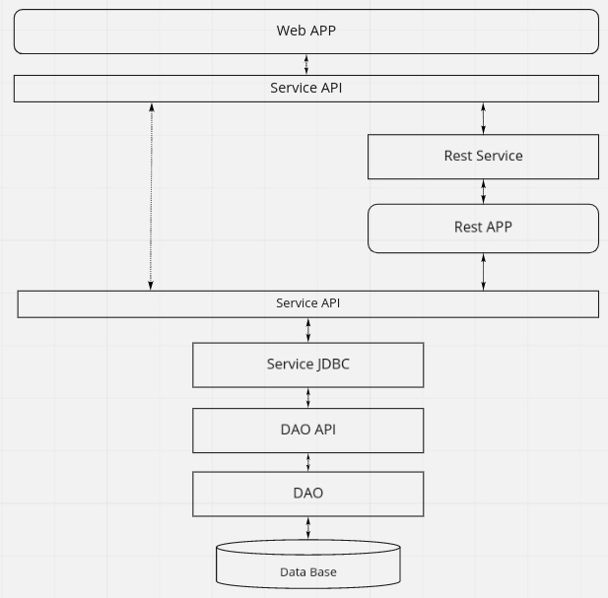
Description
There are several modules
in the project:
  Entity
  Dao-API
  Dao
  Service-API
  Service
  Rest-app
  Service-rest
  Web-app
  Test-db

Slide 3
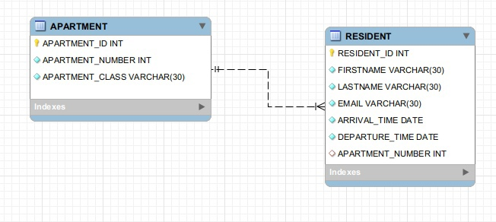
Actions
In this project I used H2 DB in memory. Test-db module is responsible for embedded DB.
There are two classes in Entity module: Apartment and Resident. Also, there is ApartmentDto class that has all Apartment’s fields and average resident time (departureTime - arrivalTime) of Resident class.
In addition I created my own annotation “CheckDate” because ArrivalTime should be before DepartureTime.

Slide 4
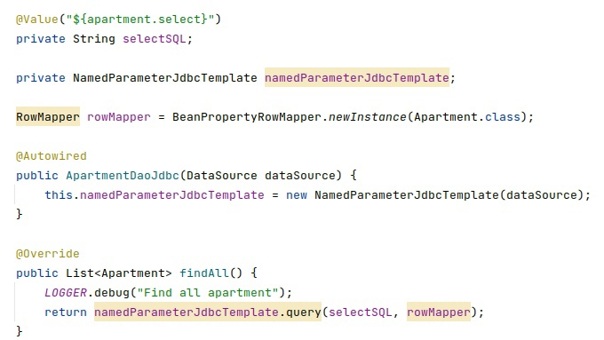
Dao
I used NamedParameterJDBCTemplate for basic JDBC operations . This wraps the JdbcTemplate and allows us to get support for named parameters with alternative syntax.
I worked with lists with the help of interface RowMapper. Implementations of this interface perform the actual work of mapping each row to a result object.
I used property files to bring in SQL queries into Dao classes.

Slide 5
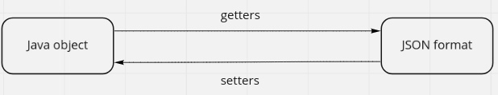
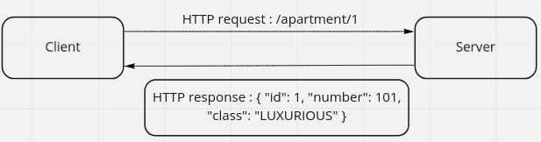
Rest-app
I used JSON format for storing and exchanging information.
When we are converting an Apartment object to JSON, the corresponding class fields are created. Keys: Integer id → “id”, and value is passed using getters. To get java object from JSON we used setters.
Spring does all the transformation work for us.

Slide 6
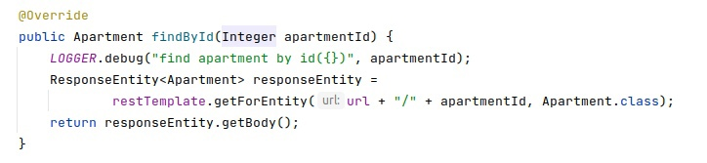
Rest-Service
I created Rest-service layer to replace the services that worked through the DAO, for services that will work through the rest.
For example, in the future, it’ll be possible to replace the implementation with SOAP.
In order to achieve this goal I used the RestTemplate, that offers template to perform common scenarios by HTTP method.

Slide 7
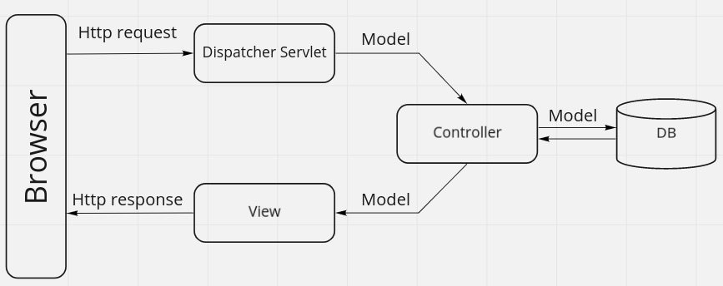
Web-app
All the incoming requests that come in the application are first intercepted by Dispatcher Servlet. And based on the fact who wants to go and where Dispatcher Servlet delegates the control to the respective controller.
I used Thymeleaf and Bootstrap 5 for view pages.

Slide 8
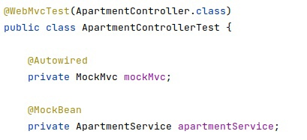
Testing
I used unit, mock and integration tests to test the application.
If we want to test the Controller, we don't need to know how the repository layer is implemented. Ideally, we should be able to write and test our Controller layer code without wiring in our full repository layer. To achieve this, we can use the mocking support provided by Spring Boot Test.
@WebMvcTest annotation can be used for a Spring MVC test that focuses only on Spring MVC components. Using this annotation will disable full auto-configuration and apply the configuration which is relevant to MVC tests.
@MockBean automatically replaces the bean of the same type in the application context with a Mockito mock.

Slide 9
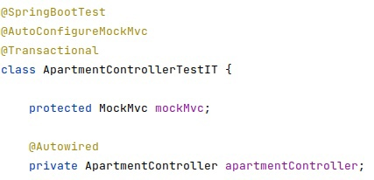
Testing
But what if we want to test the entire application?
Another useful approach is to not start the server at all but to test only the layer below that, where Spring handles the incoming HTTP request and hands it off to your controller. That way, almost of the full stack is used, and your code will be called in exactly the same way as if it were processing a real HTTP request but without the cost of starting the server.
Spring Boot provides a @SpringBootTest annotation which can be used as an alternative to the standard spring-test @ContextConfiguration annotation when you need Spring Boot features. The annotation works by creating the ApplicationContext that will be utilized in our tests.

